Slide 1
ROSSMANN STORE SALES
Group No: 278
Vishnu Pajjuri Aditya Dubey
Gauri Khatri Amrutha Gowda

Slide 2

Contents
Introduction
Data Set
Data Visualization
Data Preprocessing
Multiple Linear Regression
K-Nearest Neighbors
Naïve Bayes
Decision Tree
Random Forest
Conclusion

Slide 3
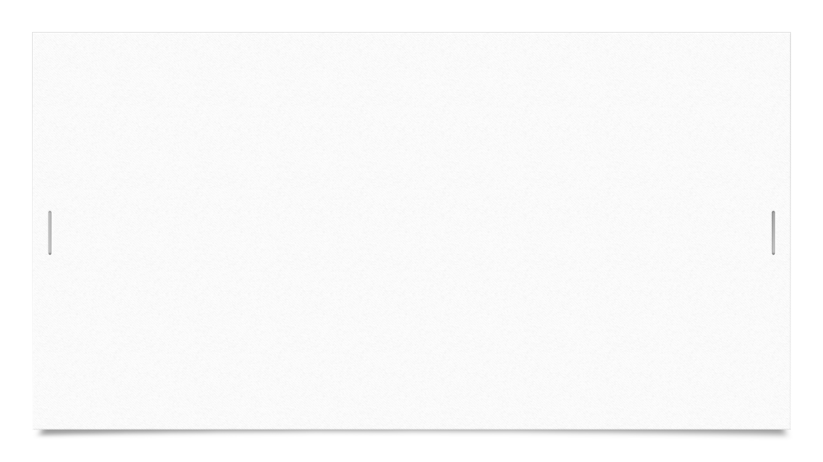

Introduction
Rossmann is a second largest drug store with over 3,790 stores across the world since 1972.
We are predicting the pattern for Rossmann sales for the business growth with help of factors like competition, school and state holidays and locality.
Analysis of the sales could help to manage stores efficiently.

Slide 4
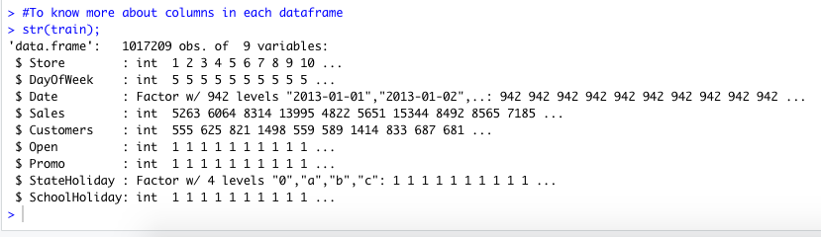
Data Set
Size of our data is 1017209 with 9 attributes.
Dependent variable: Sales
Independent variables: Open
Customers
Date
Days of week
School Holiday
State Holidays
Promotion

Slide 5
Data Visualization
Some stores are just better than the others.
Not all days of the week are equal.
Promotions do work

Slide 6
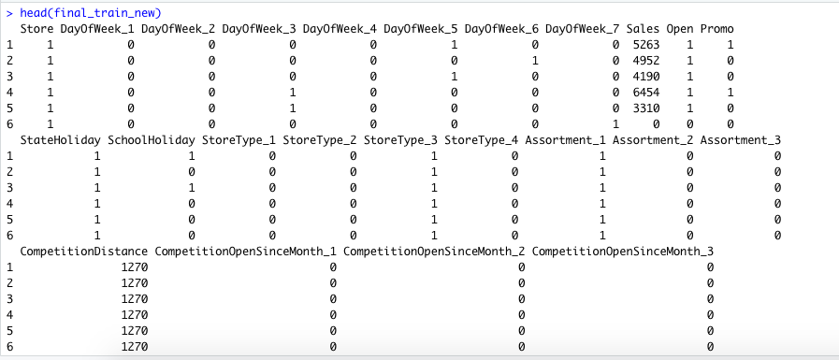
Data Preprocessing
Missing values in the data set are replaced with mean
Creating N-1 variables for categorical values like StoreType
Converting nominal to numerical variables: Yes/No to 0/1 for Promo , State Holiday, School Holiday
Remodelled the date to MM/DD/YYYY format using date function to maintain symmetric pattern throughout.

Slide 7
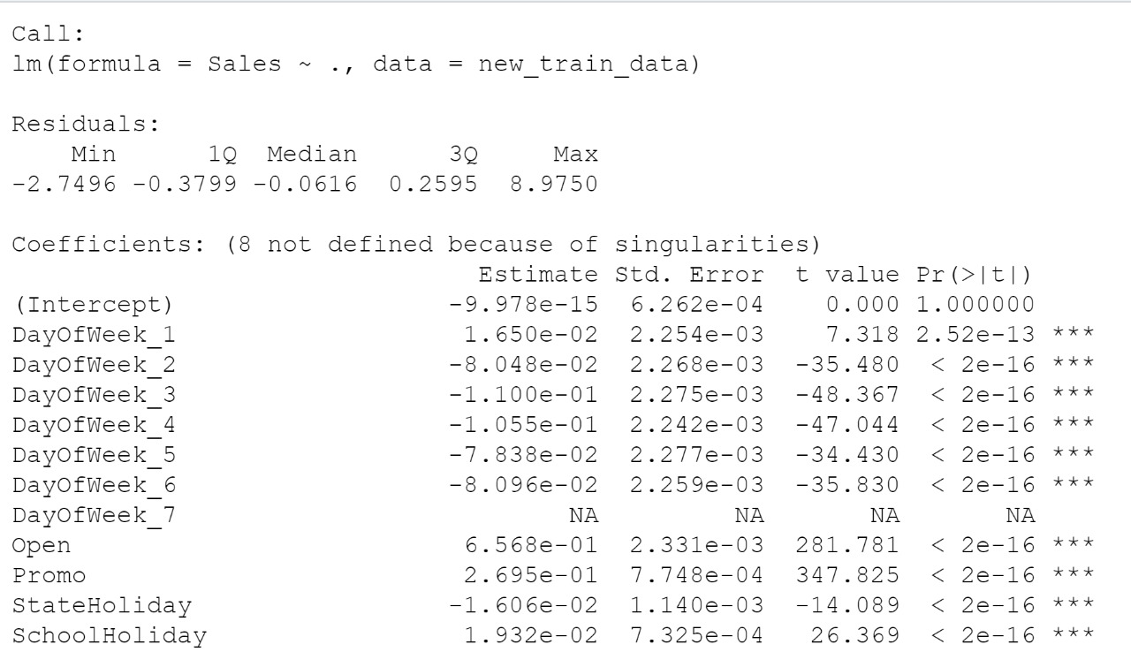
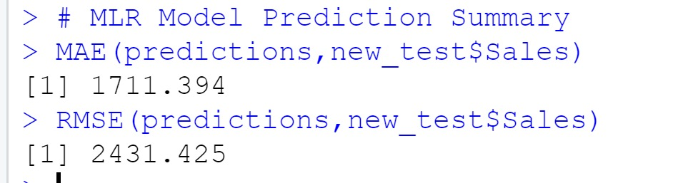
Multiple Linear Regression
At 95% confidence level, P value is less than
0.05.
There is 60.11% variation in Sales can be
explained by the variations in dependent
variables
….

Slide 8
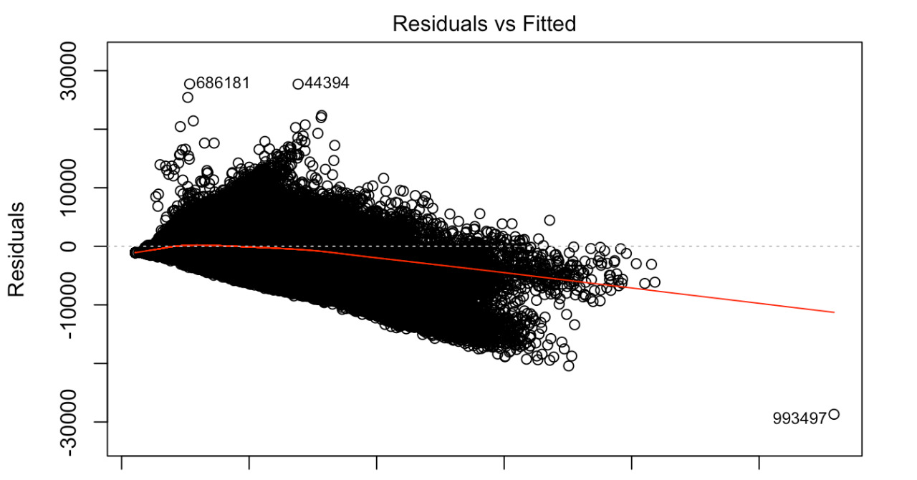

Slide 9
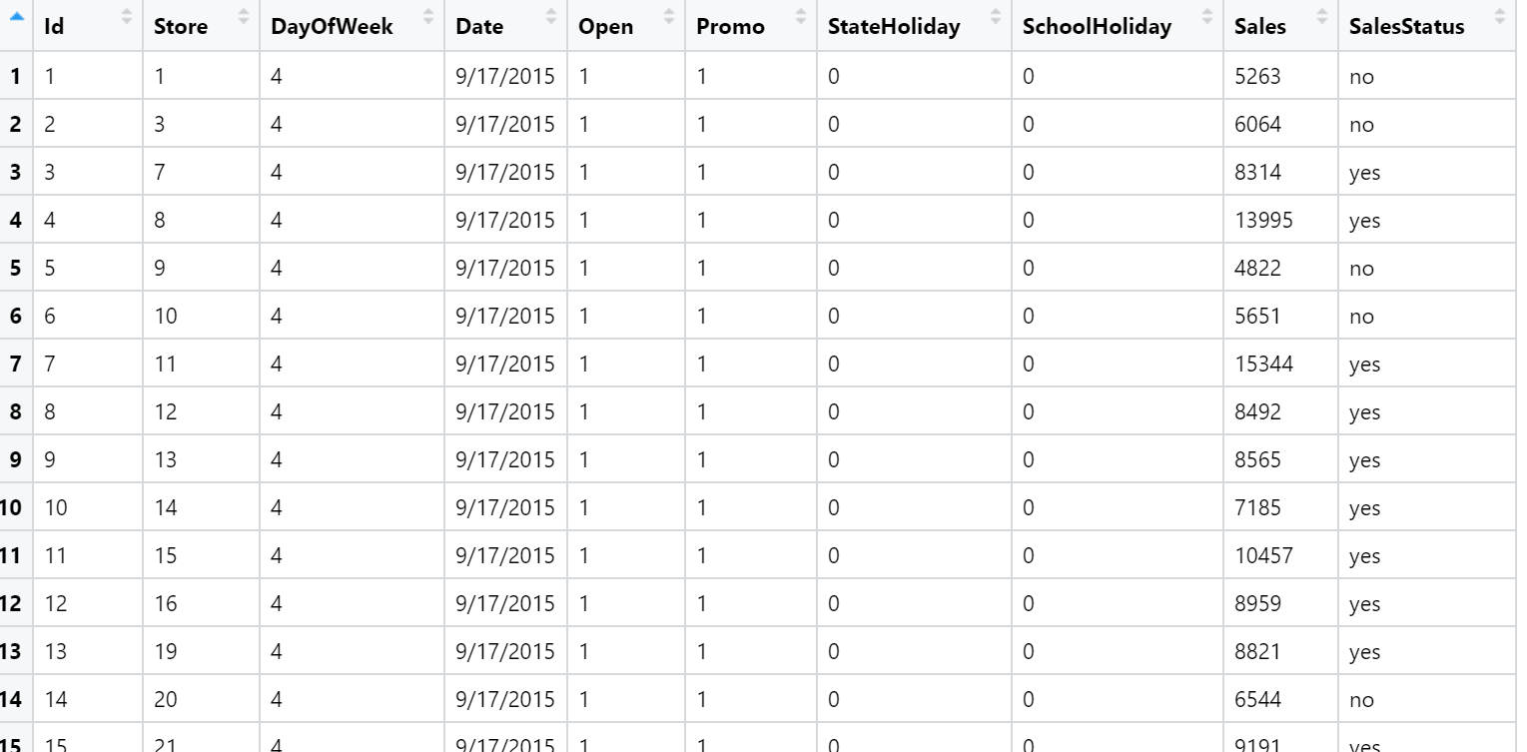
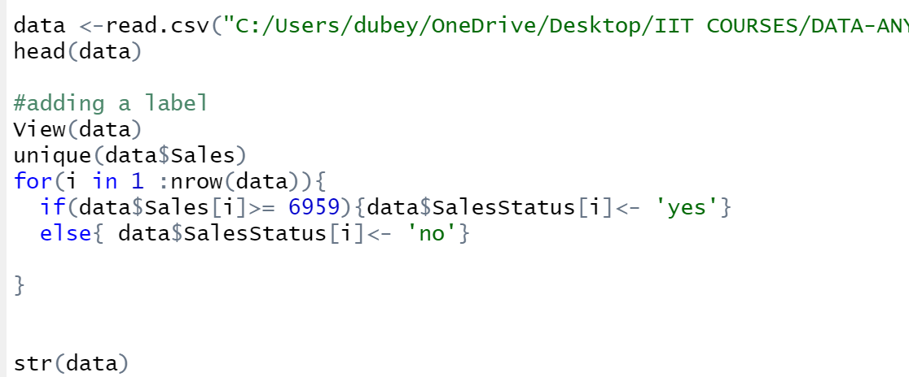
K- Nearest Neighbor- Preprocessing
Creating new label

Slide 10
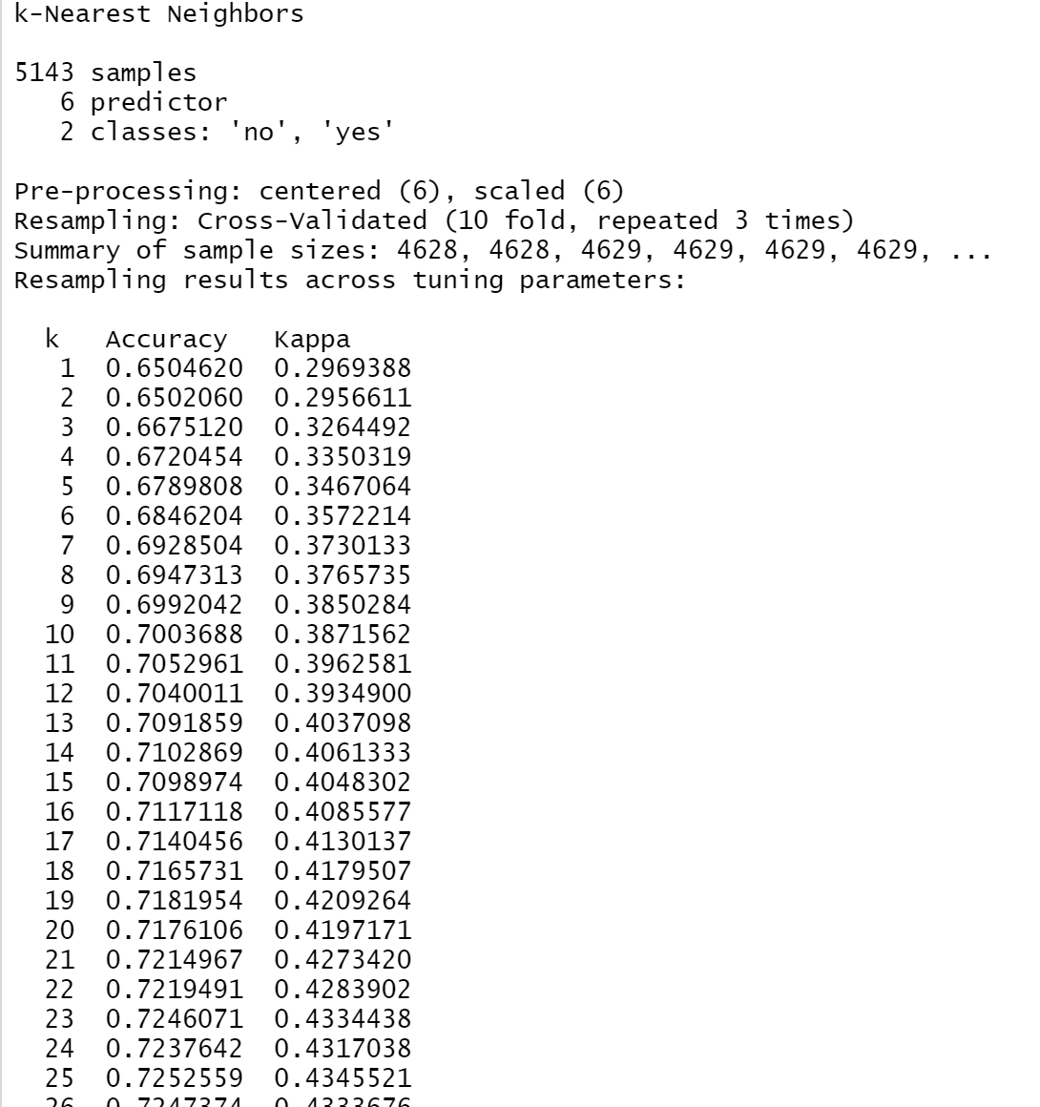
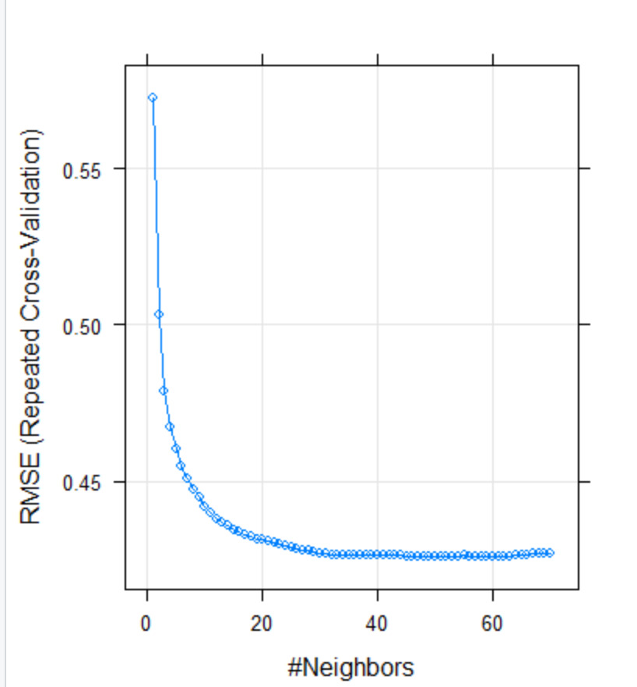
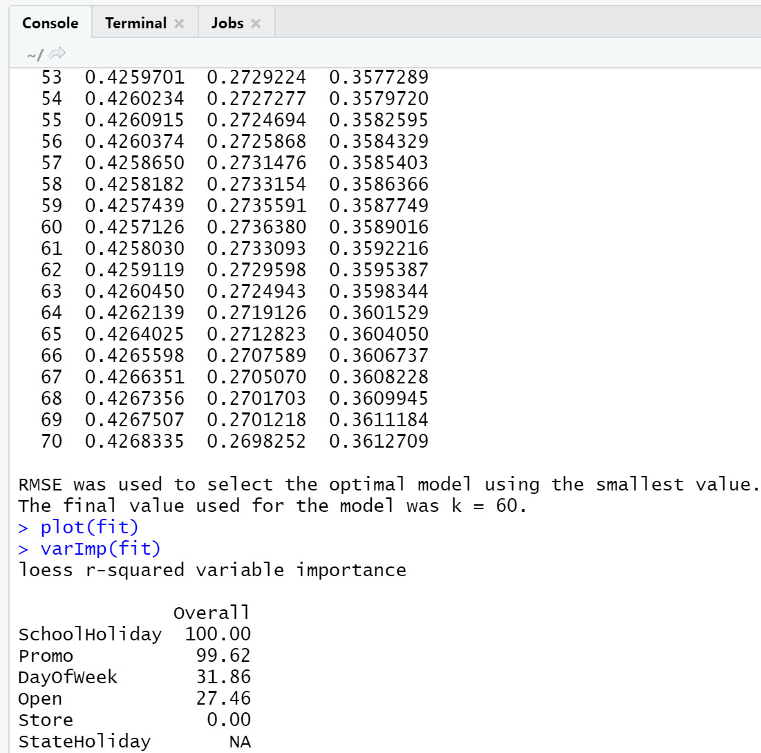
K- Nearest Neighbor
By performing KNN we get the impact of
variables on sales.
School Holiday and Promo has major impact
on the Sales.

Slide 11
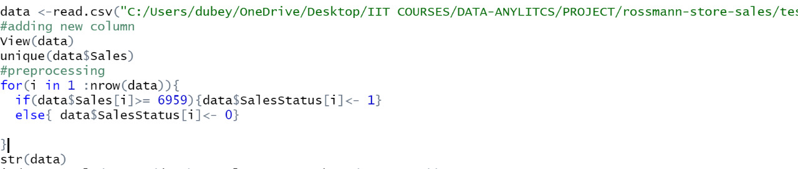
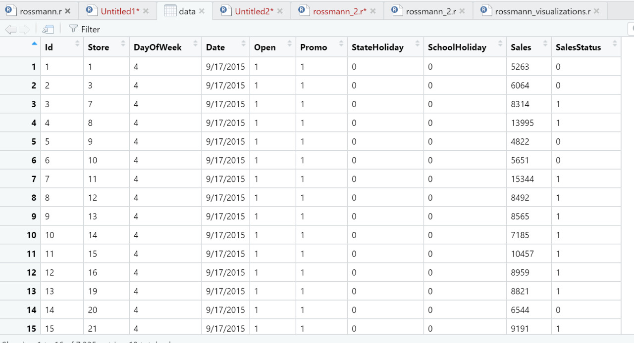
Naive Bayes
Preprocessing:
Creating a label
for Sales based on
the mean value

Slide 12
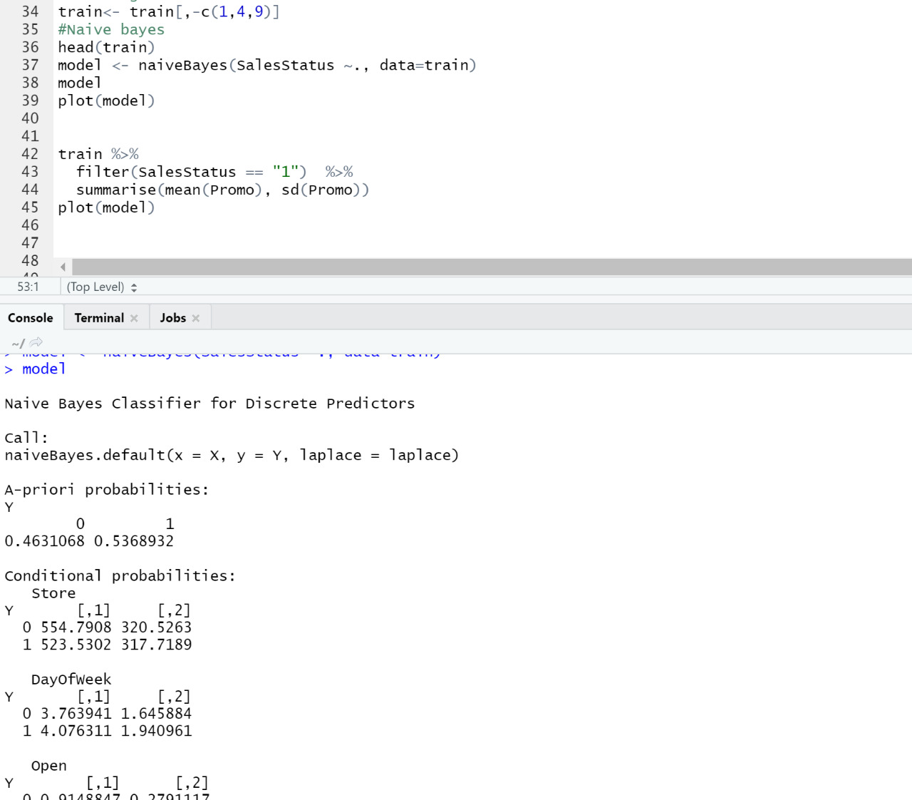
With the help of Naïve Bayes model we can predict that
46.31% - Average sales is less than Sales.
53.68% -Average sales is greater than Sales

Slide 13
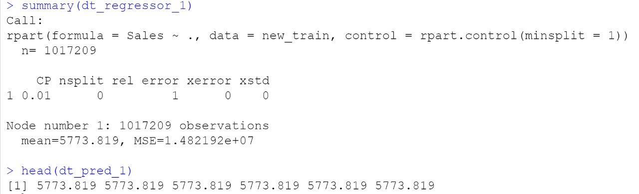
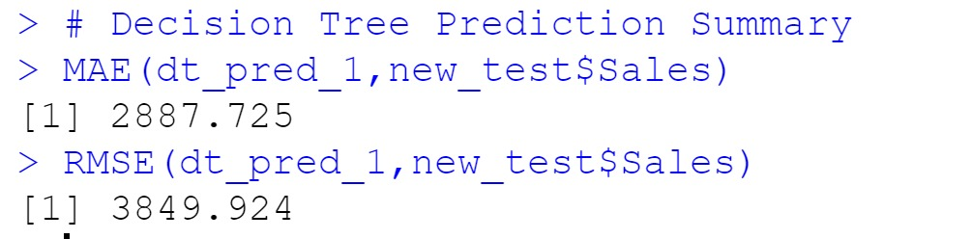
Decision Tree

Slide 14
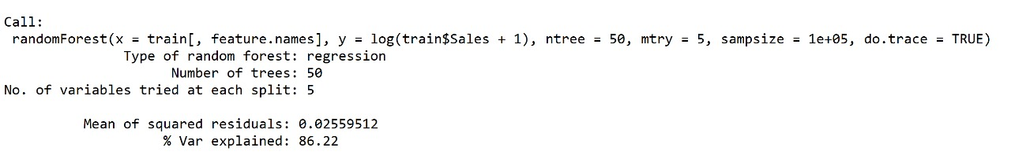
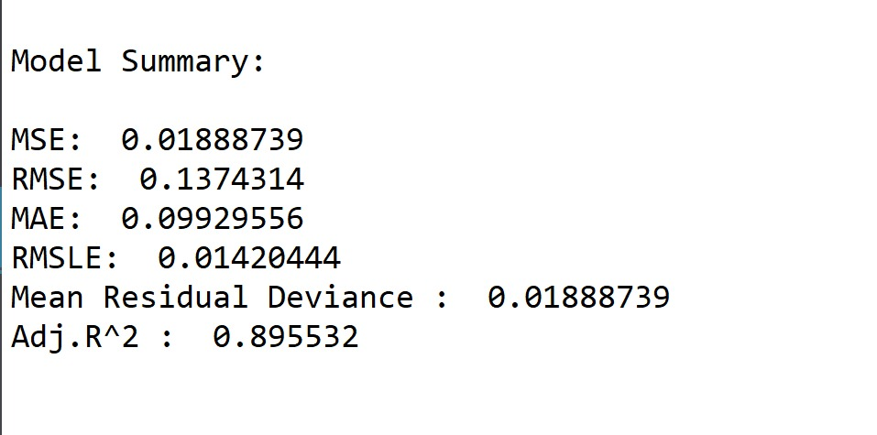
Random Forest
Number of trees is 50
Number of variables tried at each split is 5.
Adjusted R square value is 89.55% from which we can say this is the best model so far.

Slide 15
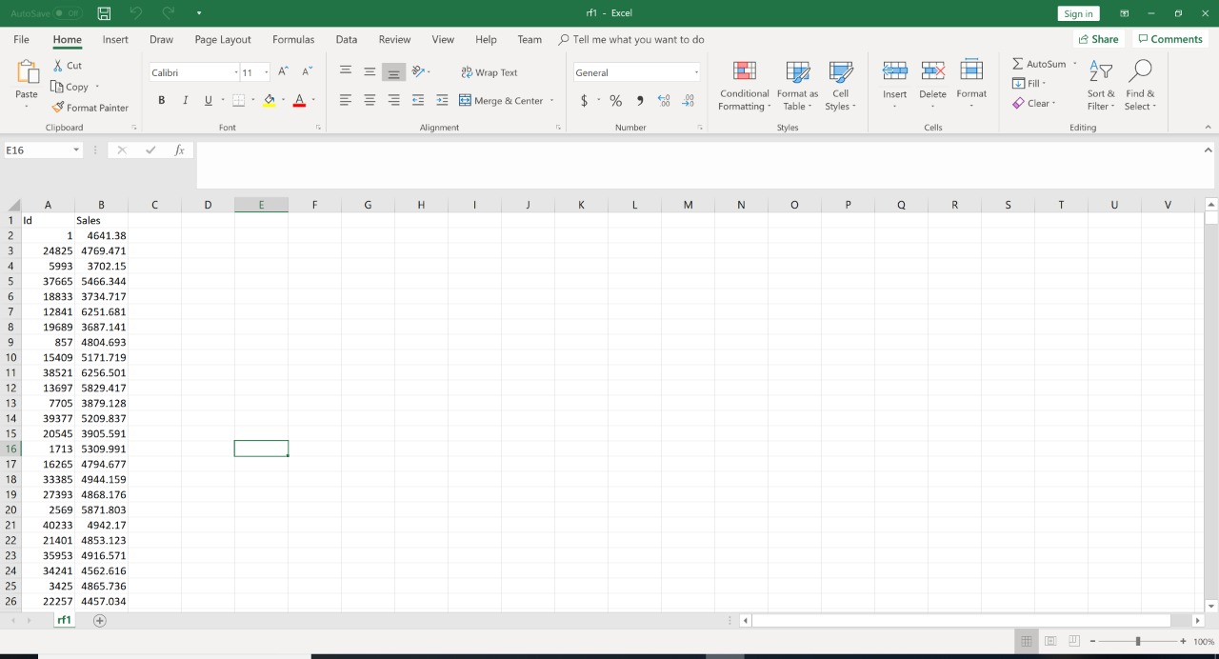
Conclusion
One can make a simple machine learning model
that predicts the sales of the Rossmann stores
with a 13.7% error. Interestingly, the model only
uses a fraction of the features provided by
Rossmann. The model can therefore be
implemented in a simple app and easily accessed
by store managers to accurately forecast sales.

Slide 16
THANK YOU!!!

